Slide 1
The Transport Layer Part 2
Gianluca Rizzo
Notes:
Welcome back to Computer Networks.
This week we will continue with the transport layer, but we will focus on the famous Transmission Control Protocol or TCP, which is arguably one of the most successful technologies of our era.

Slide 2
Outline
Process-to-process communication
UDP
TCP
Reliable data delivery
Imaginary protocol
UDP
TCP
Notes:
So far, we discussed two services provided by the transport layer: process-to-process communication (sockets etc) and reliable data delivery.
For the latter, we discussed in general terms, about families of protocols, like Go-back-N and Selective Repeat.

Slide 3
Outline
Process-to-process communication
UDP
TCP
Reliable data delivery
Imaginary protocol
UDP
TCP
Notes:
Now we will discuss specific transport-layer technologies, starting from UDP.

Slide 4
UDP: reliability elements
Checksums to detect corruption
Notes:
UDP provides only one aspect of reliable data delivery: detection of corruption. For that, it uses checksums: the sender includes in every segment a checksum (as part of the UDP header), and the receiver uses the checksum to ensure that — with a high probability — the segment was not corrupted.
Let’s…

Slide 5
Alice’s computer
Bob’s computer
rdt_send()
udt_send()
rdt_rcv()
check for corruption
deliver_data()
Notes:
visualize this:
This is the minimal transport layer that we saw in the last lecture:
A process running in Alice’s computer calls rdt_send() to send data to a process running in Bob’s computer.
Alice’s transport layer puts the data into a segment and calls udt_send() to pass the segment to the network layer.
Bob’s network layer calls rdt_rcv() to pass the segment to the transport layer.
Bob’s transport layer extracts the data from the segment and calls deliver_data() to pass the data to the target process.
The only thing that UDP adds to this is a check for corruption, in which case it drops the segment, i.e., does not deliver the data to the target process.
So, UDP does not provide reliable data delivery, it only does a corruption check.

Slide 6
Outline (from last lecture)
Process-to-process communication
UDP
TCP
Reliable data delivery
Imaginary protocol
UDP
TCP
Notes:
How about TCP?

Slide 7
TCP: reliability elements
Checksums to detect corruption
ACKs to signal successful reception
SEQs to disambiguate segments
Timeouts to detect corruption+loss
Retransmissions to recover from corruption+loss
Notes:
TCP provides all the aspects of reliable data delivery that we discussed last week: … and it does so in its own special way.

Slide 8
TCP: reliability elements
Checksums to detect corruption
ACKs to signal successful reception
SEQs to disambiguate segments
Timeouts to detect corruption+loss
Retransmissions to recover from corruption+loss
Notes:
First, we will focus on how TCP uses ACKs and SEQs.

Slide 9
Alice’s computer
Bob’s computer
rdt_send([A])
udt_send(…)
SEQ 0|
ACK 10|
[A]
rdt_rcv(…)
deliver_data([A])
rdt_send([B])
ACK 1|
[B]
udt_send(…)
SEQ 10|
rdt_rcv(…)
deliver_data([B])
Notes:
(From now on, when I say “Alice”, I mean “Alice’s transport layer” and same for Bob.)
Consider the following scenario:
The process running on Alice’s computer sends one data byte (the character “A”) to a process running on Bob’s computer.
Alice creates a segment that carries this data byte, which also carries SEQ 0.
Bob receives the segment, extracts the data byte, and delivers it to the target process.
Bob creates a segment that acknowledges receiving the data byte, which carries ACK 1.
Alice receives the segment.
The first thing to note is that Bob’s ACK number does not signal what he received, but what he is expecting: he received data byte 0, and he is expecting data byte 1, this is why he is sending ACK 1.
So: TCP uses cumulative ACKs, each one signalling the next data byte expected by the party sending the segment.
In most typical scenarios, Bob’s process also has data to send to Alice’s process. E.g., if Alice’s process is a web client and Bob’s process is a web server, Alice’s process sends an HTTP GET request, and Bob’s process responds with a file—so, both processes send data.
This means that:
After receiving Alice’s data, Bob’s process also sends data (in our example, character “B”) to Alice’s process.
Hence, Bob’s segment does not only carry ACK 1, which acknowledges that he successfully received data byte 0, it also carries a data byte and a SEQ.
When Alice receives Bob’s segment, she extracts the data byte and delivers it to the target process.
Moreover, Alice’s segment does not only carry SEQ 0, it also carries an ACK, which is the next data byte that she is expecting from Bob.
So: All TCP segments carry a SEQ and an ACK. Even if it does not seem necessary. In our example here, the segment from Alice to Bob carries ACK 10, even if Alice does not need to acknowledge receiving any data from Bob.
Where did the number 10 come from? In this example, it is arbitrary — we will see better examples later. 10 happens to be the number of the data byte that Alice is expecting next from Bob.

Slide 10
SEQs & ACKs
Data bytes are implicitly numbered
SEQ: # of the first data byte
ACK: # of the next data byte that is expected (cumulative)
Both always present, even if it appears unnecessary
Notes:
In TCP, data bytes are implicitly numbered. Why do I say “implicitly”? Because it is not the case that each data byte is labelled with an actual number.
Rather, each TCP segment, inside the TCP header, carries a SEQ. This is the number of the first data byte carried in this segment’s body.
Moreover, each TCP segment, inside the TCP header, carries an ACK, which is the number of the next data byte that the sender of the segment is expecting from the other side. TCP ACKs are cumulative.
Both SEQs and ACKs are always present in the TCP header, even if they appear unnecessary.

Slide 11
Alice’s computer
Bob’s computer
SEQ 0|
ACK 10|
[hello]
[hey!]
ACK 5|
SEQ 10|
SEQ 5|
ACK 14|
[all ok]
[bye]
SEQ 14|
ACK 11|
Notes:
Here’s another example, where Alice’s and Bob’s processes exchange small words.
Bob’s first segment carries ACK 5 because Alice sent 5 data bytes, numbered 0 (the SEQ carried by Alice’s first segment) to 4. This means that Bob is now expecting data byte 5.
Alice’s second segment carries ACK 14 because Bob sent 4 data bytes, numbered 10 (the SEQ carried by Bob’s first segment) to 13. This means that Alice is now expecting data byte 14.
Bob’s second segment carries ACK 11 because Alice sent 6 bytes, numberer 5 to 10. This means that Bob is now expecting data byte 11.
We can also guess that Alice’s first segment carries ACK 10, because that is the SEQ on the next segment that Bob sends.

Slide 12
Alice’s computer
Bob’s computer
200 bytes
SEQ 0
ACK 10
[GET request]
[file, part 1]
1500 bytes
SEQ 10
ACK 200
[file, part 2]
1500 bytes
SEQ 1510
ACK 200
SEQ 3010
[file, part 3]
100 bytes
ACK 200
SEQ 200
ACK 1510
SEQ 200
SEQ 200
ACK 3110
ACK 3010
Notes:
In this example, Alice’s process is a web client, and Bob’s process a web server. So, Alice’s process sends an HTTP GET request of 200 bytes, and Bob’s process responds with the corresponding file, divided in 3 segments.
Parenthesis: TCP cannot create segments of an arbitrary size. There is an upper bound, called Maximum Segment Size (MSS), determined by the underlying network properties. That’s typically 1500 bytes, but may vary per network.
In this example:
Alice’s first segment carries a SEQ and an ACK.
Bob’s first segment also carries a SEQ and an ACK. The ACK is 200, because Bob received Alice’s 200 bytes, numbered from 0 to 199, and is now expecting data byte 200.
Bob’s next two segments carry the same ACK number, because Alice did not send any new data, so Bob is still expecting data byte 200.
Alice responds to each of Bob’s segments with a segment that carries no data. Of course, each of these segments carries a SEQ and an ACK. The SEQ is 200, because that’s the number of the first data byte that it *would* carry if it did carry data.
So: A TCP segment that carries no data, carries a SEQ that is equal to the number of the first data byte that the segment would carry if it did carry data.

Slide 13
Simple things to remember
A TCP connection may carry bidirectional communication
A segment may or may not carry data (but it always carries a SEQ)
There exists a maximum segment size (MSS), dictated by network properties
Notes:
A few things to remember about TCP SEQs and ACKs: …

Slide 14
TCP: reliability elements
Checksums to detect corruption
ACKs to signal successful reception
SEQs to disambiguate segments
Timeouts to detect corruption+loss
Retransmissions to recover from corruption+loss
Notes:
Now we will focus on how TCP uses timeouts and retransmissions.

Slide 15
Alice’s computer
Bob’s computer
SEQ 0
X
timeout
SEQ 0
Notes:
When TCP times out, it retransmits *one* segment, which is the one with the oldest unacknowledged SEQ number.

Slide 16
How long should the timeout be?
Notes:
-> How long should the timeout be?
The timeout should be a bit longer than the round-trip time (RTT) between the sender and the receiver.
Why? Because the sender should be fairly certain that a piece of data has been lost before timing out and retransmitting it. It shouldn’t be the case that the segment carrying the data, or the segment acknowledging the data, has been delayed.
-> How should one compute the RTT?

Slide 17
Timeout calculation
RTT estimation relies on a sliding window
the current estimate depends on past estimates and a new sample, and each term is appropriately weighed.
EstimatedRTT = 0.875 EstimatedRTT + 0.125 SampleRTT
DevRTT = function(RTT variance)
Timeout = EstimatedRTT + 4 DevRTT
Empirical, conservative prediction of RTT
Notes:
RTT estimation relies on a sliding window: the current estimate depends on past estimates and a new sample, and each term is appropriately weighed.
Why is this done this way? Well, think of how Google map would predict how long it takes to go from point A to point B. It would take into account how long it took the last car to go from A to B, but it would not take into account only that one data point, because that car may have encountered some extraordinary temporary situation.
The timeout depends on the estimated RTT and a function of the RTT variance. Why take the variance into account? Because the more the RTT varies over time, the more conservative the sender needs to be when setting the timeout, so that it does not timeout prematurely.
The point is that TCP timeout calculation is empirical. It uses weights and numbers that have turned out to work well in practice. The numbers on this slide are from your book and they correspond to a particular implementation, but other implementations might use different numbers.

Slide 18
Alice’s computer
Bob’s computer
SEQ 0
SEQ 1
X
SEQ 2
SEQ 3
SEQ 4
ACK 1
ACK 1
ACK 1
ACK 1
fast retransmit
SEQ 1
Notes:
Suppose Alice sends 5 segments, each carrying 1 data byte.
Suppose Alice’s 2nd segment is lost.
When Bob receives Alice’s first segment, he responds with a segment that carries ACK 1, because that’s the next byte he is expecting from Alice.
-> When Bob receives Alice’s 3rd, 4th, and 5th segment, what ACK number does he respond with?
It’s still ACK 1, because TCP ACKs are cumulative. Bob cannot respond with ACK 3, because that would mean that he has successfully received all data bytes from 0 to 2, and he is now expecting 3, which is not the case.
So, he keeps responding with ACK 1.
When Alice receives all the duplicate ACKs, she can guess that the 2nd segment was lost.
Hence, she does not need to wait for a timeout, she can immediately retransmit.
We call this retransmission (that occurs in response not to a timeout but duplicate ACKs), a “fast retransmit”.
When it happens, Alice retransmits one segment, which is the one with the oldest unacknowledged SEQ.

Slide 19
Two retransmission triggers
Timeout => retransmission of oldest unacknowledged segment
3 duplicate ACKs => fast retransmit of oldest unacknowledged segment
avoid unnecessary wait for timeout
1 duplicate ACK not enough <= network may have reordered a data segment or duplicated an ACK
Notes:
So: In TCP, there are two events that trigger retransmission: …
Both of them result in 1 retransmission of the oldest unacknowledged segment.

Slide 20
TCP: reliability elements
Checksums to detect corruption
ACKs to signal successful reception
SEQs to disambiguate segments
Timeouts to detect corruption+loss
Retransmissions to recover from corruption+loss
Notes:
This completes our discussion of TCP’s reliability elements.

Slide 21
Is TCP Go-back-N or SR?
Go-back-N: cumulative ACKs, retransmits multiple segments
SR: selective ACKs, retransmits 1 segment on timeout
TCP: cumulative ACKs, retransmits 1 segment => Go-back-N/SR mix
Notes:
Last question before we move on: does TCP belong to the Go-back-N or to the Selective Repeat family?

Slide 22
Other key elements of TCP
Connection setup and teardown
Connection hijacking
Connection setup (SYN) flooding
Flow control
Congestion control
Notes:
TCP does not provide only reliable data delivery, it has other interesting elements.

Slide 23
TCP elements
Connection setup and teardown
Connection hijacking
Connection setup (SYN) flooding
Flow control
Congestion control
Notes:
Let’s look at TCP connection setup and teardown.

Slide 24
Alice’s computer
Bob’s computer
connection socket
listening socket
SYN|SEQ x|ACK -
SYN|SEQ y|ACK x+1
connection socket
SEQ x+1|ACK y+1|[data]
send buffer
send buffer
receive buffer
receive buffer
connection established
Notes:
This is an example of a TCP connection setup:
Bob’s process has opened a listening socket.
Alice’s process creates a connection socket to communicate with Bob’s process. As a result, Alice sends a connection setup request to Bob. That’s a segment that carries what is called the SYN flag (which is basically a particular bit in the TCP header). It also carries a SEQ and an ACK (though the value of the ACK is irrelevant).
When Bob receives the connection setup request, it passes it to Bob’s process. If the process accepts the request, that creates a connection socket for communicating with Alice’s process. In response, Bob sends a segment that also carries the SYN flag. It also carries a SEQ (that has nothing to do with Alice’s SEQ) and an ACK (which is Alice’s SEQ + 1, i.e., it acknowledges that Bob received the connection setup request and is now expecting the first data byte).
When Alice receives Bob’s response, she allocates a send and a receive buffer for this particular TCP connection. Then she sends another segment that may carry data.
When Bob receive’s Alice’s 2nd segment, he also allocates a send and a receive buffer for this particular TCP connection. At this point, we say that Alice and Bob have established a TCP connection.

Slide 25
Alice’s computer
Bob’s computer
connection socket
listening socket
FIN
connection socket
ACK
FIN
send buffer
send buffer
ACK
receive buffer
receive buffer
connection closed
Notes:
When Alice’s process does not need to send any more data to Bob’s process, Alice sends a segment to Bob that carries what is called a FIN flag (which is another bit in the TCP header).
When Bob receives it, he acknowledges it like any other segment, and deletes his receive buffer, because Alice will not be sending any more data on this connection.
Alice also deletes her send buffer.
When Bob’s process does not need to send any more data to Alice’s process, Bob sends a segment to Alice that carries the FIN flag.
When Alice receives it, she acknowledges it like any other segment, and deletes her receive buffer.
Bob also deletes his send buffer.
At this point, Alice and Bob can release all the resources that were dedicated to this connection, including the connection sockets, and we say that Alice and Bob have closed their TCP connection.
Beware, the listening socket is still there, because it is not bound to a particular TCP connection, it’s listening for new connection-setup requests.

Slide 26
Connection setup
3-way handshake
“TCP client”: end-system initiating the handshake
“TCP server”: the other end-system
First 2 segments carry a SYN flag
1-bit field in the TCP header
“TCP connection” = resources (sockets, buffers…) allocated for communication
Notes:
So:
A TCP connection setup occurs though a 3-way handshake. We use the term “TCP client” to refer to the entity that initiates the handshake, and “TCP server” to the other entity.
The first 2 segments carry a SYN flag, which is a 1-bit field in the TCP header.
When we say that two end-systems have “established a TCP connection,” we mean that they have allocated all the resources, like sockets and buffers, that are necessary for their communication.

Slide 27
Congestion control
Goal: not overwhelm the network
not send at a rate that the would create network congestion
How: “congestion window”
number of unacknowledged bytes that the sender can transmit without creating congestion
sender estimates it on its own
Notes:
The goal of flow control was to protect the receiver from being overwhelmed; the goal of congestion control is to protect the network from being overwhelmed, from being congested.
To achieve this, the sender uses various techniques to estimate a “congestion window” = the max number of unacknowledged bytes it should send so as to avoid contributing to congestion.
-> Why is congestion control more complicated than flow control? For flow control, the receiver tells the sender how many bytes the sender may send so as not to overwhelm the receiver. Why can’t we do congestion control in a similar way? Why can’t someone tell the sender how many bytes it may send so as not to overwhelm the network?

Slide 28
Bandwidth-delay product
Max amount of traffic that the sender can transmit until it gets the first ACK
= the maximum congestion window size that makes sense

Slide 29
Alice’s computer
Bob’s computer
[data]
[data]
[data]
[data]
ACK
[data]
ACK
[data]
ACK
[data]
ACK
[data]
ACK
ACK
ACK
ACK
R bit/s
x
RTT s
bandwidth
delay
product
Notes:
Let’s see how TCP congestion control works.
First of all, what is the maximum congestion window size that makes sense?
You have already answered this:
Alice can keep sending unacknowledged bytes until she receives an ACK for the first segment she sent out.
In this case, Alice transmits data at some rate R (which is her throughput to Bob) and for a period of RTT (the round-trip time to Bob).
Hence, she transmits a total of R x RTT bits.
This is called the bandwidth-delay product, and it is the maximum amount of traffic that Alice can transmit before receiving an ACK.
Increasing the sender window beyond this does not make any sense, because it will not increase Alice’s throughput to Bob.

Slide 30
Alice’s computer
Bob’s computer
[data]
ACK
[data]
[data]
X
X
timeout
[data]
Notes:
A TCP sender does not always use the maximum sender window size possible.
To avoid congestion, it makes sense to be conservative:
Alice starts out cautiously: she first sends out a single segment.
If she gets an ACK for the data she sent out, she becomes more optimistic and sends out more segments.
If she times out waiting for an ACK, she retransmits, but she also goes back to sending a single segment.

Slide 31
TCP congestion windows is managed via self-clocking
Sender guesses the “right” congestion window based on the ACKs
ACK = no congestion, increase window
No ACK = congestion, decrease window
What algorithm exactly does TCP use to increase and decrease the window size?
Notes:
This behavior of TCP is called self-clocking.
It refers to the fact that TCP, on the sender side, on its own determines the right congestion window based on the ACKs it gets from the receiver.
Every time the sender gets an ACK, this indicates that there was no congestion,
so it increases the window.
Every time the sender does not get an ACK, this indicates that there was congestion, so it decreases the window.

Slide 32
Alice’s computer
Bob’s computer
N=100 bytes
SEQ 0
0 - 99
ACK 100
N=200 bytes
SEQ 100
100 - 199
SEQ 200
200 - 299
ACK 200
N=300 bytes
ACK 300
300 - 399
SEQ 300
400 - 499
SEQ 400
N=400 bytes
500 - 599
SEQ 500
SEQ 600
600 - 699
Notes:
Alice has established a TCP connection to Bob and wants to send him data.
The maximum segment size (MSS) of the network between them is 100 bytes.
Let’s first consider the case where there is no packet loss.
In this case:
Alice sets her congestion window to 1 MSS.
So, she sends 1 segment carrying 100 bytes (SEQ 0).
When she receives ACK 100,
which means that Bob received bytes 0-99,
she increases her congestion window by 1 MSS,
which means that she can now send up to 200 un-ACK-ed bytes.
When she receives ACK 200,
which means that Bob received bytes 100-199,
she again increases her congestion window by 1 MSS,
which means that she can now send up to 300 un-ACK-ed bytes.
She has already sent 100 un-ACK-ed bytes (SEQ 200),
so she sends 200 more (SEQs 300 and 400).
When Alice receives ACK 300,
which means that Bob received bytes 200-299,
she again increases her congestion window by 1 MSS,
which means that she can now send 400 un-ACK-ed bytes.
She has already sent 200 un-ACK-ed bytes (SEQs 300 and 400),
so she sends 200 more (SEQs 500 and 600).

Slide 33
Speed of increase in window size is exponential!
by 1 MSS for every ACKed segment
=> window doubles every RTT!
when we do not expect congestion
Notes:
So: When the sender has no reason to expect congestion, it increases the congestion window size by 1MSS with every ACK-ed segment, and this results in doubling the congestion window every RTT.

Slide 34
Alice’s computer
Bob’s computer
N=100 bytes
SEQ 0
N=200 bytes
SEQ 100
SEQ 200
N=300 bytes
N=400 bytes
SEQ 300
SEQ 400
SEQ 500
SEQ 600
Notes:
I will squeeze things a bit to give you a better sense of how things happen over time.
In summary:
- Alice starts out cautiously, by sending 1 segment.
- Every time she receives a new ACK number, she increases her congestion window by 1 MSS.
As a result, Alice **doubles** the size of her congestion window every RTT: after 1 RTT the window size is 200 bytes; after 2RTTs, it is 400 bytes.
Differently said, Alice increases the size of her congestion window exponentially as a function of time.

Slide 35
Alice’s computer
Bob’s computer
N=400 bytes
SEQ 300
X
SEQ 400
SEQ 500
X
SEQ 600
X
X
timeout
ssthresh= 200 bytes
N=100 bytes
Notes:
We are at the point where Alice has increased her congestion window to 400 bytes.
Alice sends 4 segments, carrying a total of 400 bytes.
Suppose they are all lost.
In this case:
Alice times out waiting for a new ACK.
She sets her “congestion threshold” (ssthresh) to half the current window size.
She resets her congestion window to 1 MSS.
And she starts from the beginning (see next slide)…

Slide 36
Alice’s computer
Bob’s computer
N=100 bytes
SEQ 300
ACK 400
N=200 bytes
SEQ 400
SEQ 500
ACK 500
N=250 bytes
ACK 600
N=290 bytes
SEQ 600
SEQ 700
SEQ 750
SEQ 850
ACK 700
N=324 bytes
Notes:
Alice retransmits the oldest un-ACK-ed segment (SEQ 300).
When she receives ACK 400, she increases her congestion window by 1 MSS.
So, she sends 200 bytes (SEQs 400 and 500).
When she receives ACK 500,
according to what we have said so far, we would expect her to increase her congestion window by 1 MSS (i.e., to 300 bytes) and send 200 more bytes.
But is this a good idea?
No, because last time she increased her congestion window beyond 200 bytes, there was packet loss, and this is likely to happen again.
Instead, Alice becomes more cautious:
When she receives ACK 500, she increases her congestion window to only 250 bytes.
She has already sent 100 un-ACK-ed bytes (SEQ 500), so she sends 150 more bytes (SEQs 600 and 700).
When she receives ACK 600, she increases her congestion window to only 290 bytes.
She has already sent 150 un-ACK-ed bytes (SEQs 600 and 700), so she sends 140 more bytes (SEQs 750 and 850).
When she receives ACK 700, she increases her congestion window to 324 bytes. And so on.
You are wondering how exactly these congestion window sizes are chosen, and I will tell you precisely in a moment.

Slide 37
Increase window size
Exponentially
by 1 MSS for every ACKed segment
= window doubles every RTT
when we do not expect congestion
Linearly
by MSS*MSS/N for every ACKed segment
= by 1 MSS every RTT
when we expect congestion
Notes:
So:
TCP has 2 ways of increasing the congestion window:
- When TCP does not expect congestion,
it increases the congestion window by 1 MSS every time a new ACK is received,
which results in doubling the congestion window every RTT.
We call this an exponential increase, because the congestion window increases exponentially over time.
- When TCP does expect congestion,
it increases the congestion window by MSS*MSS/N, where N is the current congestion window size, every time a new ACK is received, which results in increasing the congestion window by roughly 1 MSS every RTT.
We call this a linear increase, because the congestion window increases linearly over time.
-> Where does this weird formula, MSS*MSS/N, come from?

Slide 38
Alice’s computer
Bob’s computer
N=100 bytes
SEQ 0
ACK 100
N=200 bytes
SEQ 100
SEQ 200
ACK 200
ACK 300
N=300 bytes
SEQ 300
N=400 bytes
X
SEQ 400
X
SEQ 500
X
SEQ 600
X
timeout
ssthresh= 200 bytes
Notes:
Let’s see this from the beginning:
Alice starts out cautiously, setting her congestion window to 1 MSS = 100 bytes.
Every time she receives a new ACK, she increases her congestion window by 1 MSS = 100 bytes;
as a result she doubles her congestion window every RTT.
If a timeout occurs, Alice sets the congestion threshold to half her current congestion window (200 bytes, in our example), resets her congestion window to 1 MSS, and starts from the beginning…

Slide 39
Alice’s computer
Bob’s computer
N=100 bytes
SEQ 300
ACK 400
N=200 bytes
SEQ 400
SEQ 500
ACK 500
N=250 bytes
ACK 600
N=290 bytes
SEQ 600
SEQ 700
SEQ 750
SEQ 850
ACK 700
N=324 bytes
Notes:
At first, Alice increases her congestion window “optimistically,” i.e., by 1 MSS with every new ACK.
However, when her congestion window reaches ssthresh, she becomes more cautious: she increases her congestion window “conservatively,” such that it increases by roughly 1 MSS every RTT.
In this way, Alice quickly finds out what are her limits,
what is the max rate at which she can send traffic without suffering any packet loss.
Whenever she approaches that rate, she becomes more careful in increasing her congestion window.

Slide 40
Basic algorithm (Tahoe)
Set window to 1 MSS, increase exponentially
On timeout, reset window to 1 MSS, set ssthresh to last window/2
On reaching ssthresh, transition to linear increase
Notes:
This is the basic idea behind the TCP “Tahoe” congestion-control algorithm…

Slide 41

Alice’s computer
Bob’s computer
N=400 bytes
300 - 399
SEQ 300
X
SEQ 400
400 - 499
SEQ 500
500 - 599
SEQ 600
600 - 699
ACK 300
ACK 300
ACK 300
fast retransmit
N=500 bytes
SEQ 300
SEQ 700
700 - 799
ACK 700
N=200 bytes
SEQ 800
ssthresh= 200 bytes
Notes:
We are back at the point where Alice has increased her congestion window to 400 bytes.
Alice sends 4 segments, carrying a total of 400 bytes.
Suppose the first one gets lost.
In this case:
Alice receives 3 duplicate ACKs (3x ACK 300).
This makes her suspect that the segment with SEQ 300 was lost, while the next 3 segments were received (it’s a very good explanation of why Bob would sent 3x ACK 300).
Given this suspicion, Alice does a “fast retransmit”: she retransmits the segment she suspects lost (SEQ 300) **without waiting for a timeout**.
Moreover, she sets ssthresh to half her congestion window
and reduces her congestion window.
However, she does not reset it to 1 MSS (this would be an overreaction, given that only 1 segment was lost).
Instead, she wants to set it to her congestion threshold (which is 200 bytes, in our example), since this was the last congestion window for which Alice did not experience any packet loss.
However, there is a problem:
Imagine, for a moment, that Alice sets her congestion window to 200 bytes,
which means that she can send 200 un-ACK-ed bytes.
She has already sent 400 un-ACK-ed bytes (SEQs 300 — 600).
Hence, she has already exceeded her congestion window,
which means that she can send 0 bytes.
The problem is the following:
The segments with SEQs 400, 500, and 600 are officially un-ACK-ed.
However, Alice believes that Bob received them because of his 3 duplicate ACKs. So, Alice does not want to treat these segments as un-ACK-ed.
The solution to this problem is for Alice to “inflate” her congestion window by 3 MSS’s (which is 300 bytes, in our example).
So, Alice sets her congestion window to 500 bytes,
which means that she can now send 500 un-ACK-ed bytes.
She has already sent 400 un-ACK-ed bytes (SEQs 300 — 600), so she can send 100 more bytes (SEQ 700).
Then, Alice enters a “fast recovery” phase:
Every time she receives a new duplicate ACK (another ACK 300), she increases her congestion window by 1 MSS.
The moment she receives a new ACK (ACK 700, in our example), she concludes that Bob finally received the lost segment,
she exits fast recovery, she sets her window to her congestion threshold (200 bytes, in our example), and (since her congestion window is now equal to her congestion threshold) she transitions to linear increase.

Slide 42
Basic algorithm (Reno)
Set window to 1 MSS, increase exponentially
On timeout, reset window to 1 MSS, set ssthresh to last window/2, retransmit
On receiving 3 duplicate ACKs, set window to ssthresh (+inflation), retransmit
On reaching ssthresh transition to linear increase
Notes:
This is the basic idea behind the TCP “Reno” congestion-control algorithm, which is more recent than Tahoe, and which is essentially Tahoe + the fast retransmit mechanism and the fast recovery phase.
This is not the latest TCP congestion-control algorithm. There is at least New Reno and Cubic, which are used by state-of-the-art operating systems. We will not examine them in this course, but you know everything you need to to explore them on your own.

Slide 43
new ACK
new ACK
window = window + MSS
window = window + MSS*MSS/window
window >= ssthresh
exponential increase
linear increase
timeout
ssthresh = window/2
timeout
window = MSS
ssthresh = window/2
retransmit
window = MSS
retransmit
Notes:
The Tahoe state machine.

Slide 44
new ACK
new ACK
window = window + MSS
window = window + MSS * [factor<1]
window >= ssthresh
exponential increase
linear increase
3 duplicate ACKs
ssthresh = window/2
timeout
window = ssthresh + 3 MSS
ssthresh = window/2
fast retransmit
window = MSS
new ACK
timeout
retransmit
ssthresh = window/2
window = ssthresh
window = MSS
timeout
retransmit
fast recovery
3 duplicate ACKs
ssthresh = window/2
duplicate ACK
window = threshold + 3 MSS
window = window + MSS
fast retransmit
Notes:
The Reno state machine.
Clarification: When TCP is on the fast recovery state and there is a timeout, it sets ssthresh to window/2, the window to MSS, and retransmits, before transitioning to exponential increase. But I did not have room to show all this.

Slide 45
TCP terminology
Exponential increase = slow start
it’s called slow, because it starts from a small window; but it’s not really slow, the window increases exponentially
Linear increase = congestion avoidance
this term does make sense; it means that TCP expects congestion, so it increases the window more cautiously
Notes:
A word of caution about TCP terminology: …
In summary, TCP congestion control acts like a child who wants chocolate: it starts by asking for a little bit, then increasingly asks for more, until it approaches the limit where her parents previously refused to give her more; as she approaches the limit more and more she asks more and more cautiously, to see if she could maybe exceed the limit this time.

Slide 46
TCP Reno and New Reno
TCP Reno detects packet loss via 3 duplicate ACKs and performs fast retransmit + fast recovery
it assumes only one packet is lost;
if multiple packets are lost in the same window, it often falls back to slow start.
TCP New Reno improves this by handling multiple packet losses within one window:
it stays in fast recovery and retransmits missing packets one-by-one without returning to slow start.

Slide 47
TCP Binary Increase Congestion Control (often called TCP Binary)
designed for high-speed, long-distance networks (high bandwidth-delay product).
Instead of linear growth, it uses a binary search strategy to find the optimal congestion window after packet loss.
It increases the window quickly at first, then more cautiously as it approaches the previous maximum.

Slide 48
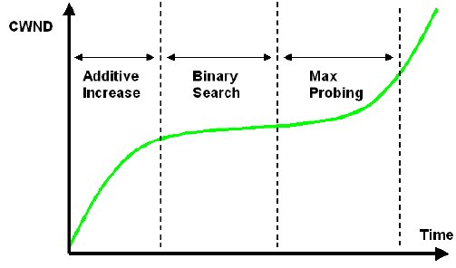
Congestion window evolution

Slide 49
TCP Cubic
Why another TCP version?
Improves the performance of TCP in high-speed and long-distance networks.
Improves overt TCP BIC with better fairness and easy implementation.
The window growth function is
W(t) = C(t - K)³ + Wmax
C represents scaling constant, t represents time passed since last window reduction, K represents time taken by function to increase W to Wmax, and Wmax represents window size before the last reduction.

Slide 50
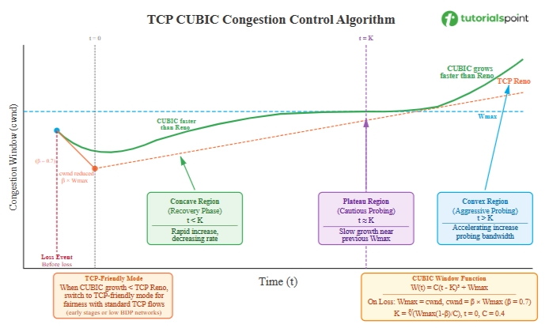

Slide 51
TCP Cubic
Concave Region
Just after a loss event, when t < K, it represents the concave region of cubic function. In this region, the window increases quickly but at decreasing rate. This helps to recover quickly towards the previous Wmax value. It is also known as Fast Recovery region.
Plateau Region (Cautious Probing)
When t ≈ K, the window is near Wmax. The cubic function flattens out, so there is slow growth in this region. It helps in avoiding immediate congestion after reaching the previous maximum. It is also known as Cautious Probing region.
Convex Region (Aggressive Probing)
When t > K, after surpassing Wmax without loss, the function enters the convex region. This window increases at a very fast rate to probe for additional available bandwidth. It is also known as Aggressive Probing region.
TCP-Friendly Region
In TCP-Friendly region, the cubic function grows slower than TCP Reno. CUBIC algorithm switches to a TCP-friendly mode to ensure fairness with standard TCP flows.

Slide 52
What “TCP friendly” means?
In networks with short RTT or moderate BDP, CUBIC is tuned so that its long‑term average window size (and thus throughput) is roughly the same as standard TCP under the same loss rate.
This fairness to TCP is important because:
Many flows on the Internet still use standard TCP.
An overly aggressive new algorithm would “steal” bandwidth and hurt those flows.

Slide 53
Loss Handling in TCP CUBIC
In case of packet loss, CUBIC algorithm does the following:
It sets Wmax to the current cwnd.
It reduces cwnd using multiplicative decrease to 70% of current cwnd (β = 0.7).
It resets the timer t = 0.
It calculates K = ((Wmax - cwnd)/C)^(1/3) for the new cubic iteration.

Slide 54
TCP CUBIC: Pros and cons
The advantages of TCP CUBIC are:
Better scalability in high bandwidth-delay product networks.
Window growth does not depend on RTT which makes bandwidth sharing fair.
Simpler implementation than TCP BIC since CUBIC has single cubic function.
Limitations:
In some network conditions, it leads to (some extra) packet loss.

Slide 55
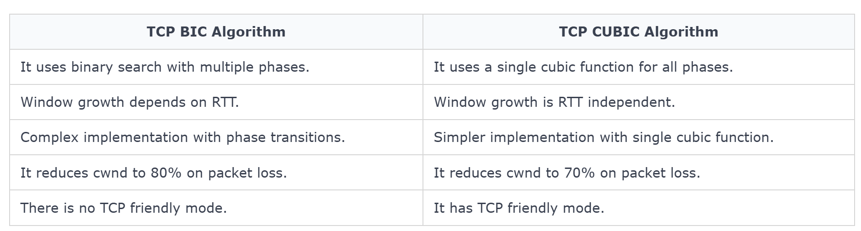
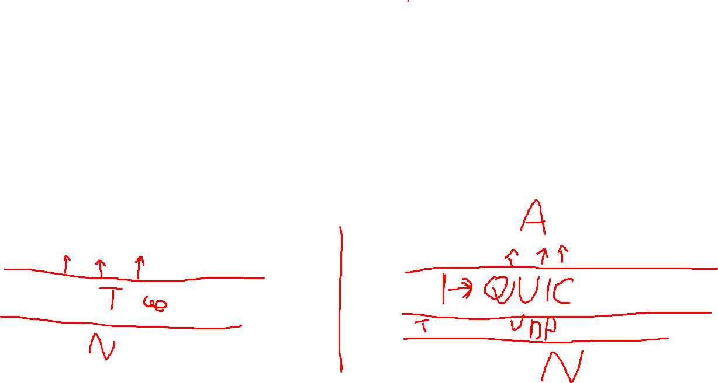

Slide 56
QUIC and TCP: Why a New Transport?
TCP is the classic Internet transport, widely used for reliable, ordered delivery between endpoints.
QUIC is a modern transport built over UDP, designed to provide reliable delivery, low-latency setup, and secure communication.
Main motivation: improve web performance, especially for modern applications and HTTP/3.

Slide 57
How QUIC Differs from TCP
Faster connection setup: QUIC combines transport and security setup more efficiently, enabling 1-RTT setup and 0-RTT resumption in some cases.
Built-in security: QUIC integrates TLS 1.3 into the protocol; encryption is mandatory.
Runs over UDP in user space: this makes deployment and protocol evolution easier than kernel-based TCP changes.

Slide 58
Key Technical Advantages
Independent streams: QUIC supports multiple streams in one connection, so loss in one stream does not block delivery of others at the transport level.
Connection migration: QUIC can keep a connection alive when the client changes IP address or network path, such as Wi‑Fi to mobile.
Better latency behavior: QUIC was designed for lower handshake delay and improved responsiveness on today’s Internet paths.

Slide 59
Flow Control in TCP

Slide 60
Alice’s computer
Bob’s computer
receive buffer
rx-win 100
[100 bytes]
rx-win 0
rx-win 0
rx-win 50
Notes:
The goal of flow control is to protect a receiver from being overwhelmed by a sender.
To achieve it, the receiver communicates to the sender up to how many bytes the sender can send to it. This number is equal to the free space in the receiver’s receive buffer (allocated for this particular connection).
This information is stored in a TCP header field called “receiver window”.
In this example, Bob has 100 bytes left in his receive buffer, so he tells Alice that she can send him up to 100 bytes.
It is possible that the receiver window “closes”, which means that the receiver tells the sender that it cannot send any more bytes (for the moment). If this happens, the sender needs to periodically probe the receiver, i.e., send a segment that carries no data or new ACK, just to elicit another segment in response, such that the receiver can communicate the new receiver-window value.

Slide 61
Flow control
Goal: not overwhelm the receiver
not send at a rate that the receiver cannot handle
How: “receiver window”
spare room in receiver’s rx buffer
receiver communicates it to sender as TCP header field

